Slide 1




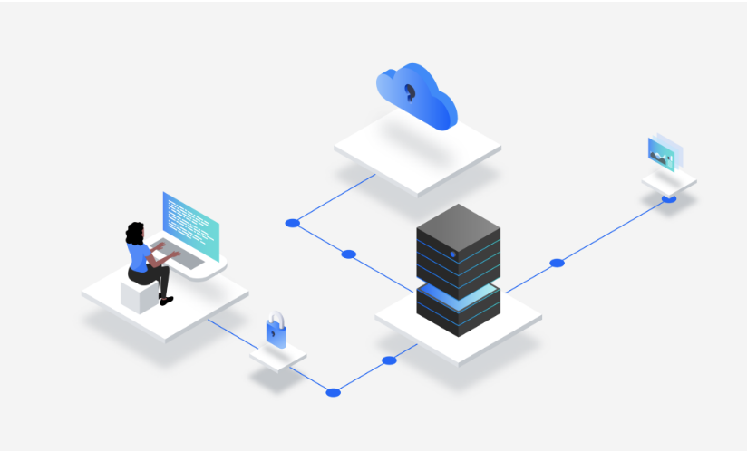
IBM Storage Fusion
High-Performance Container Workloads:
Utilize bare metal infrastructure to achieve optimal performance for containerized applications.
Container Native Storage (CNS) ensures efficient storage management for these workloads.
Appliance for Watsonx: An appliance specifically designed to support IBM's Watsonx platform. It provides a pre-configured environment for developing, testing, and deploying applications using Watsons capabilities, streamlining the development process.
Resource Efficiency: Eliminate the resource overhead associated with virtualization on the control plane, allowing more resources to be dedicated to running containerized workloads.
Solutions
Appliance for Cloud Pak:
An appliance tailored for IBM Cloud Paks, offering a pre-configured environment for deploying containerized applications using Cloud Paks. It simplifies the adoption of Cloud Paks and accelerates the application development lifecycle.
Disaster Recovery and Redundancy:
Hosted control plane and container-native storage contribute to improved disaster recovery and redundancy capabilities, ensuring high availability for critical data.

